Slide 1
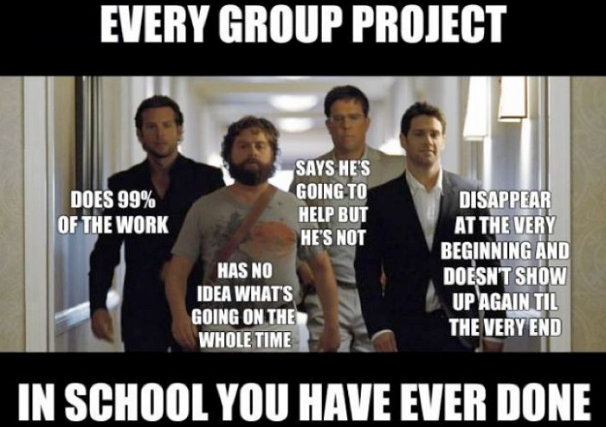
Science Safety Skit
Your first group PROJECT!!!

Slide 2
Project Description
You will work with your Lab Group to create a Safety Skit. Once you choose a safety rule, you will work together to create a “play” demonstrating the safety rule. Make this activity fun and enjoyable for everyone!

Slide 3
What we are doing today…
Turn to INB pg. 6
TITLE: Safety Skit Comic
Write down the safety rule you choose
Write your groups’ names down
Brainstorm and come up with a skit detailing your safety rule
Create a 4 box comic strip showing your play in action

Slide 5
Rules for Project
EVERY student needs a role in the skit
Not everyone has to speak
It can be serious, funny, etc.
There will be props (beakers, goggles, lab utensils)
Make this activity fun and enjoyable for everyone
PRESENTATIONS ARE WEDNESDAY (30sec. To 2min.)

Slide 6
Safety rule assignments

